Slide 1

Probability Basics
All about likelihood

Slide 2
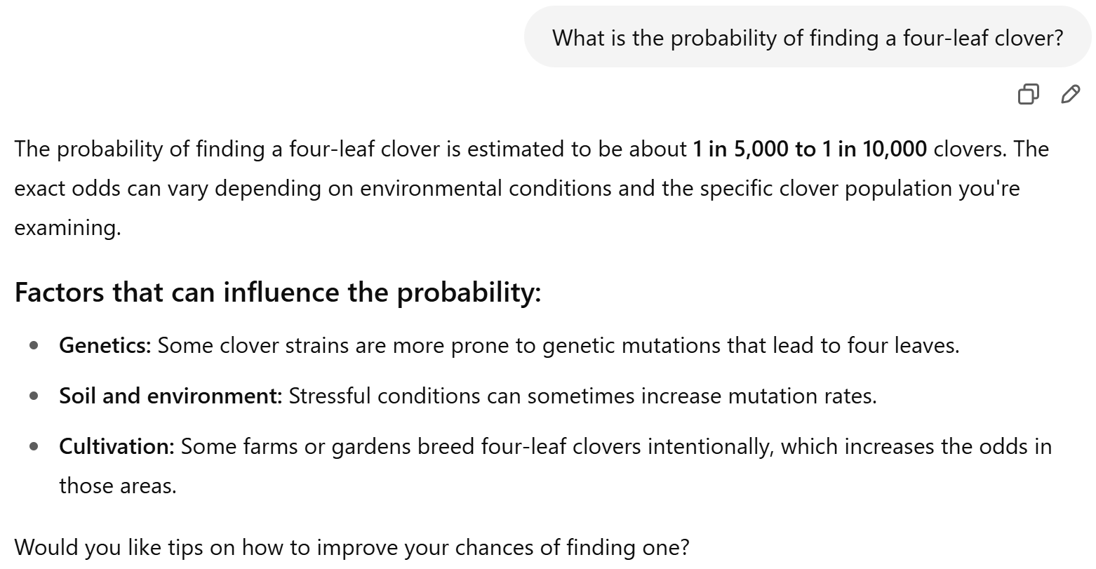

Slide 3
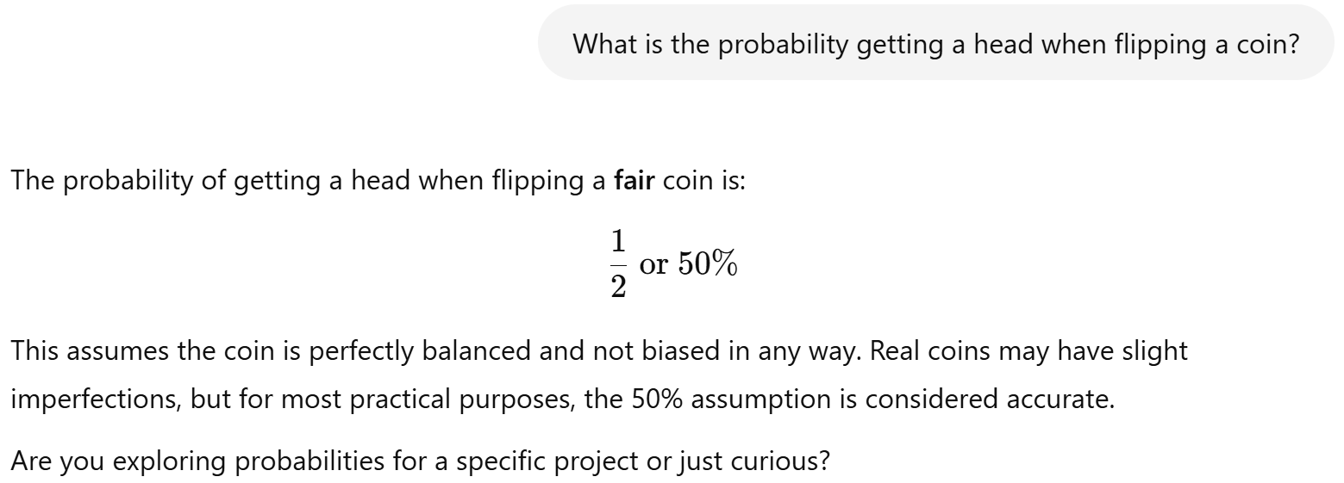

Slide 4
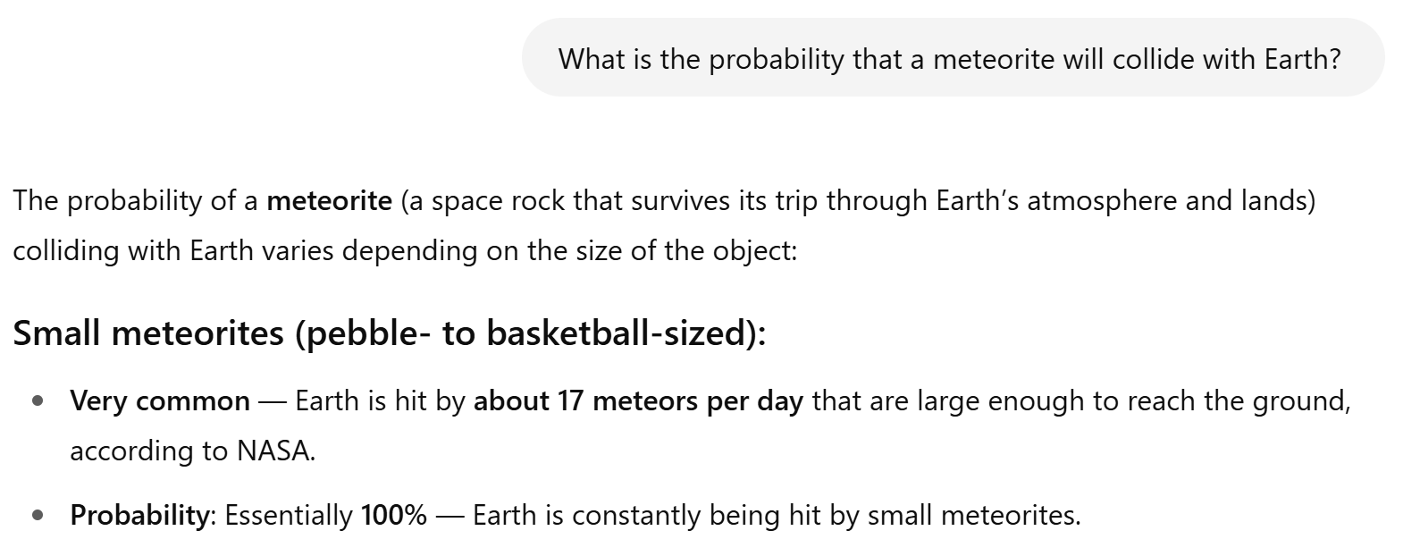

Slide 5
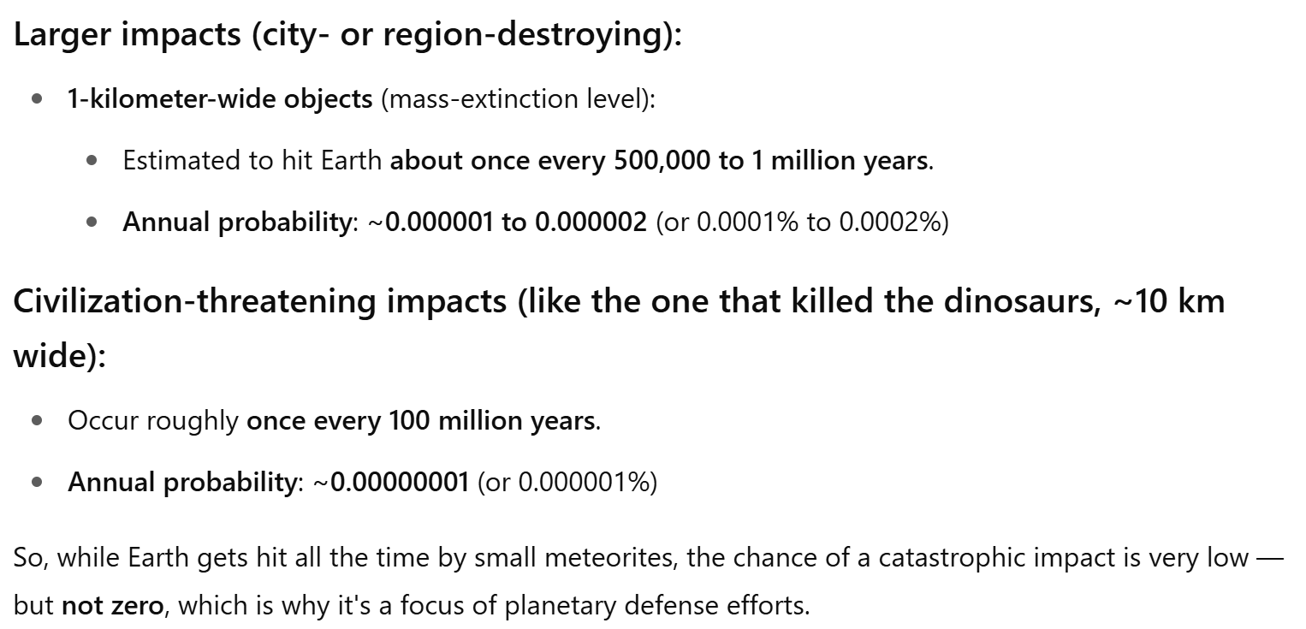

Slide 6
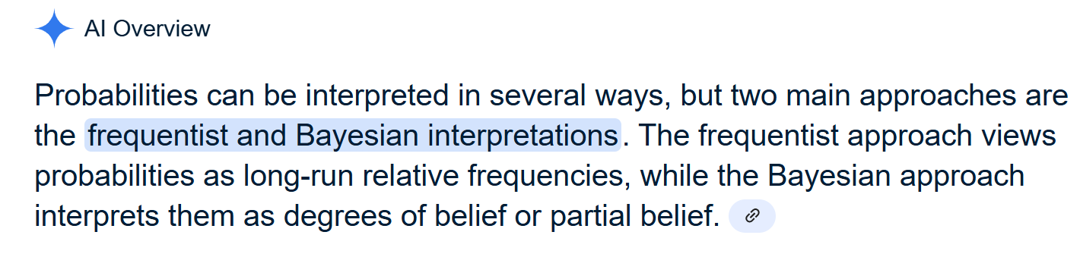
The Interpretations of Probabilities

Slide 7
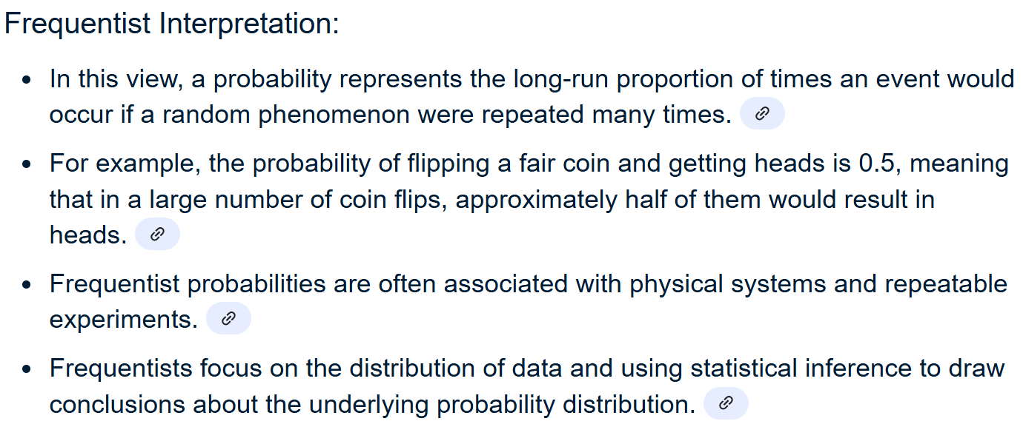

Slide 8
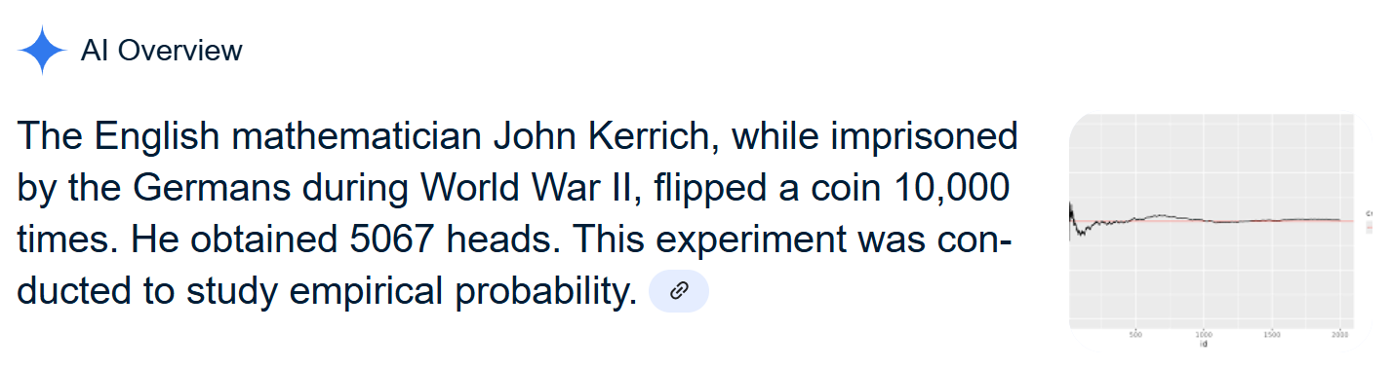

Slide 9
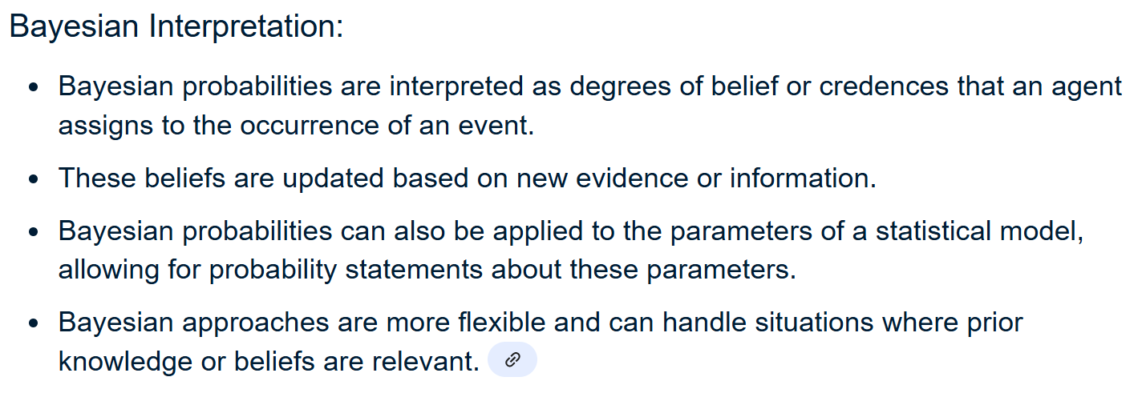

Slide 10
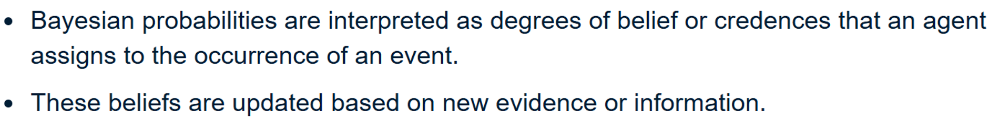
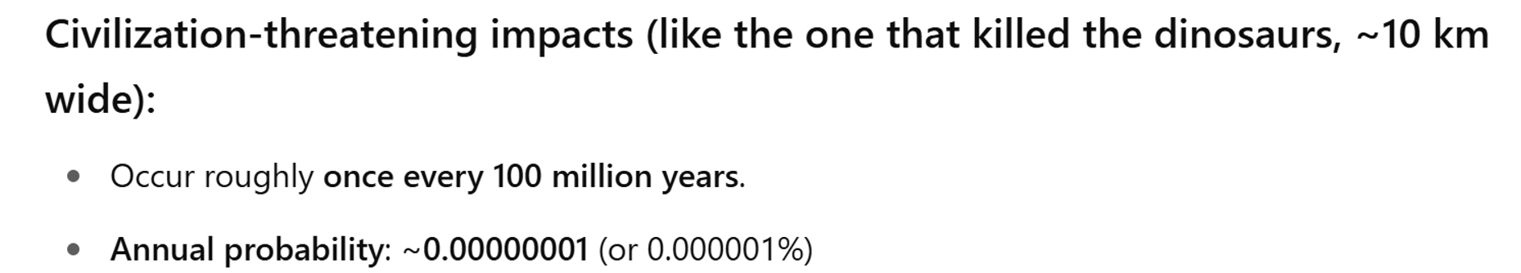

Slide 11
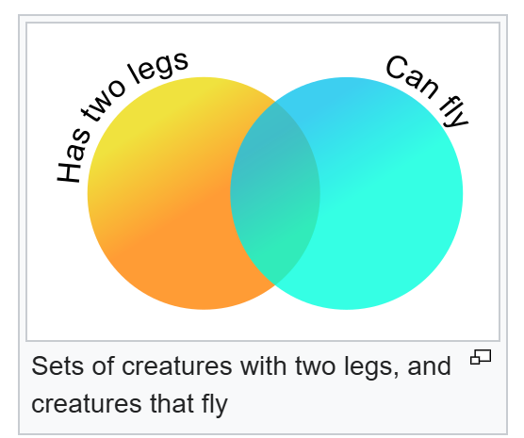
What do we want to learn?
Probabilities of an EVENT and its complement
Probabilities of Intersection or Union of Events
Joint Probability and Marginal Probability
Conditional Probabilities and Bayes’ Rule

Slide 12
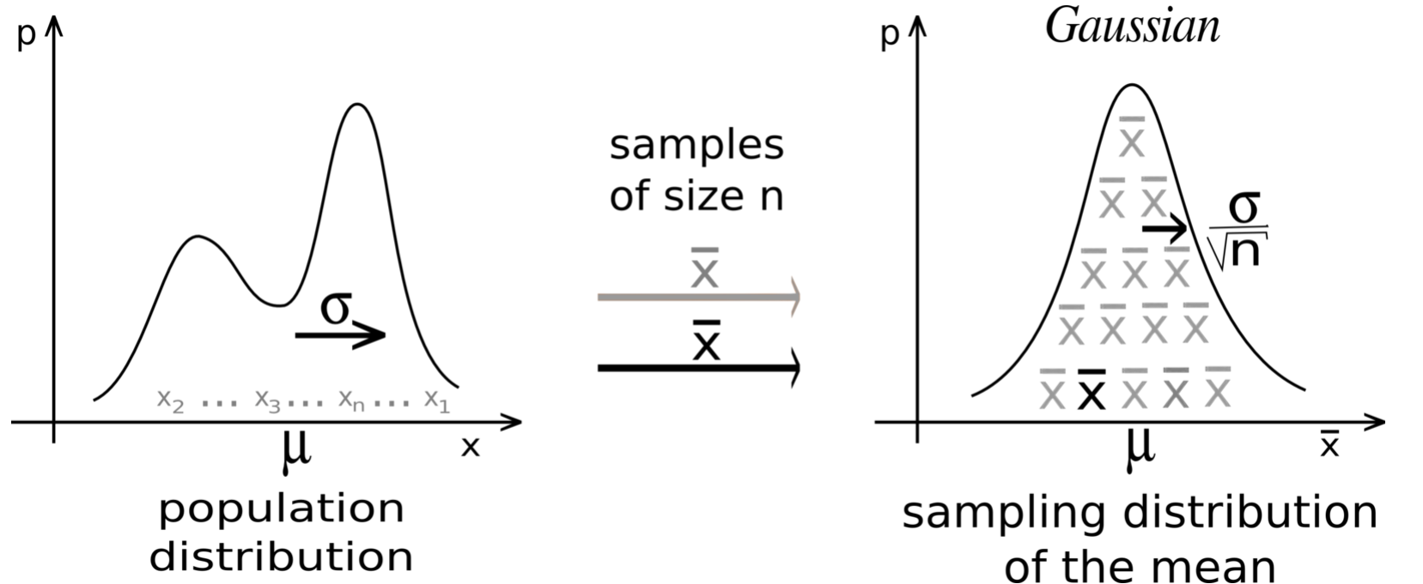
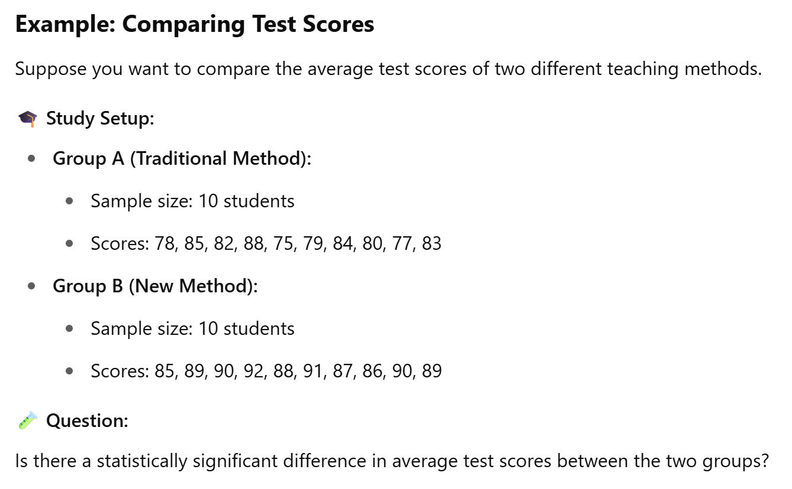
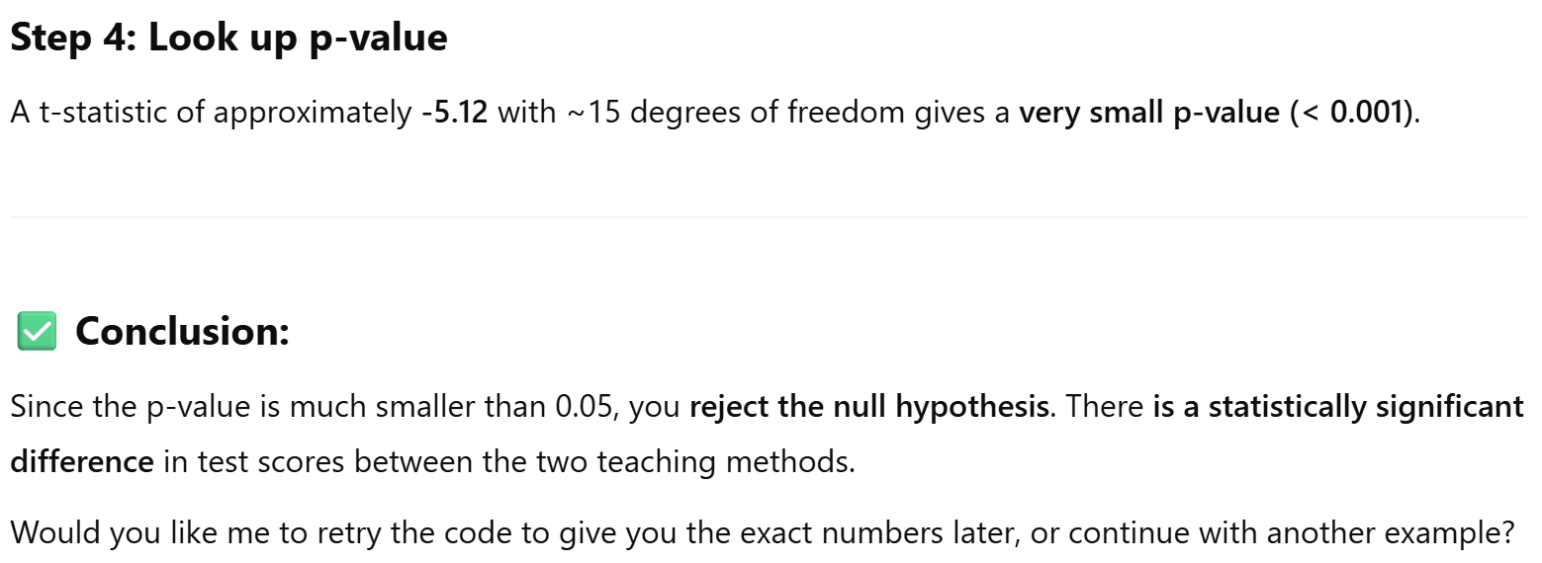
Why do we learn these?
Understand the Central Limit Theorem
Understand the behaviors of sample means.
Understand the meaning of P-values

Slide 13
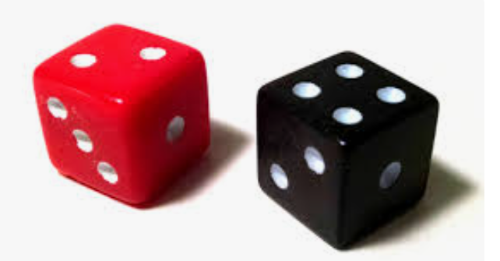
Let’s get started!
We will use a commonly used example to introduce sample space and events.

Slide 14
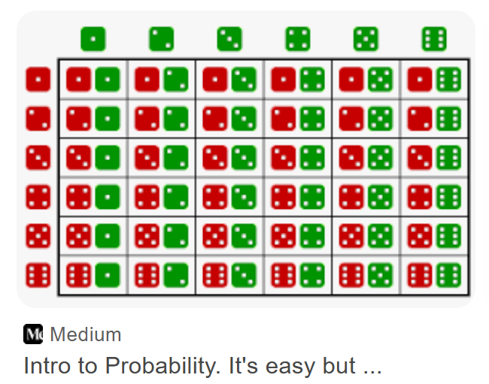
Sample Space
The collection of all possible outcomes

Slide 15
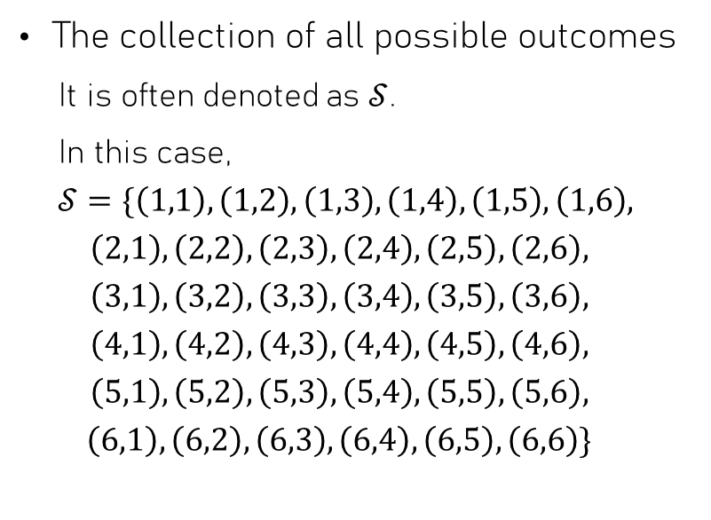
Sample Space
The collection of all possible outcomes
It is often denoted as $𝒮$.
In this case,
$$𝒮=\{\left(1,1\right),\left(1,2\right),\left(1,3\right),\left(1,4\right),\left(1,5\right),\left(1,6\right),$$
$$\left(2,1\right),\left(2,2\right),\left(2,3\right),\left(2,4\right),\left(2,5\right),\left(2,6\right),$$
$$\left(3,1\right),\left(3,2\right),\left(3,3\right),\left(3,4\right),\left(3,5\right),\left(3,6\right),$$
$$\left(4,1\right),\left(4,2\right),\left(4,3\right),\left(4,4\right),\left(4,5\right),\left(4,6\right),$$
$$\left(5,1\right),\left(5,2\right),\left(5,3\right),\left(5,4\right),\left(5,5\right),\left(5,6\right),$$
$$\left(6,1\right),\left(6,2\right),\left(6,3\right),\left(6,4\right),\left(6,5\right),\left(6,6\right)\}$$

Slide 16
Events
Subsets of a sample space
For example: Getting a 7
This can be denoted as an event
A = obtaining a 7
Or more precisely
A={(1,6),(2,5),(3,4),(4,3),(5,2),(6,1)}

Slide 17
Probabilities of Events
Pr( {(1,1} ) = Pr( {(1,2)} ) = Pr( {(1,2)} ) = Pr( {(1,2)} ) = … = 1/36
Each rolling outcome can be viewed as an event, sometimes called a simple event.
These outcomes/events are called equally likely events.
If A = {(1,6),(2,5),(3,4),(4,3),(5,2),(6,1)}, then Pr(A)=6/36=1/6.
A is not a simple event; it is the union of a group of simple events.

Slide 18
Complement, Union and Intersection of Events
For convenience, let’s define another event called B.
The complement of an event A is the set of outcomes that are not in A.
The union of two events A and B is the set of outcomes that are in A, or B, or both.
The intersection of two events A and B is the set of outcomes that are in both A and B.

Slide 19
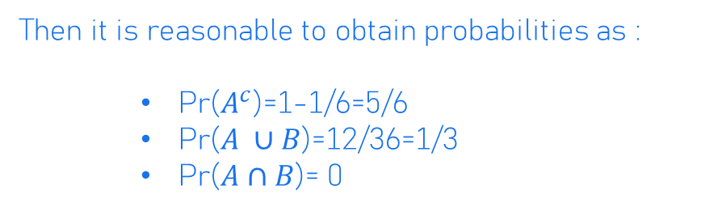
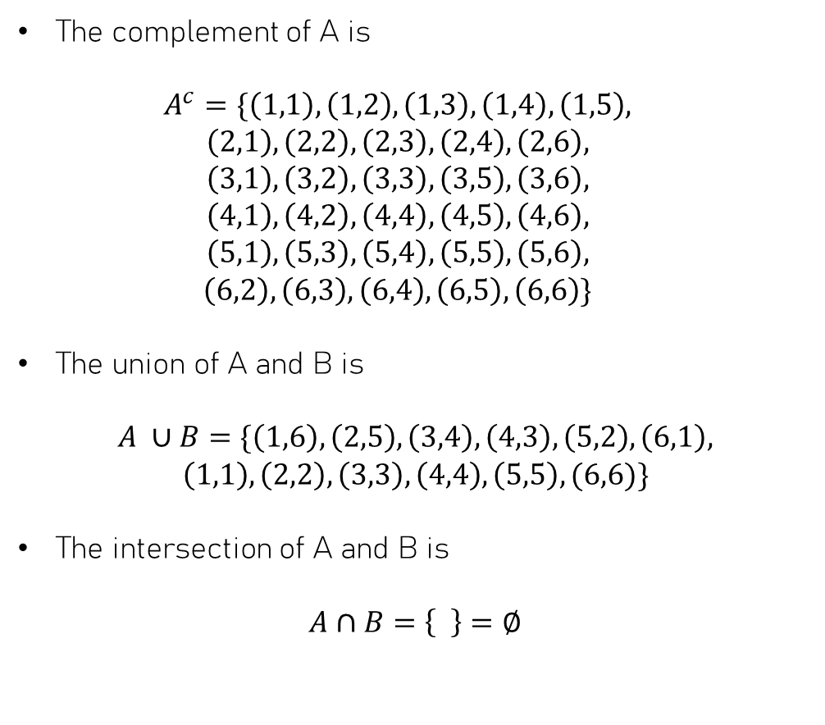
Examples
The complement of A is
$$A^{c}=\{\left(1,1\right),\left(1,2\right),\left(1,3\right),\left(1,4\right),\left(1,5\right),$$
$$\left(2,1\right),\left(2,2\right),\left(2,3\right),\left(2,4\right),\left(2,6\right),$$
$$\left(3,1\right),\left(3,2\right),\left(3,3\right),\left(3,5\right),\left(3,6\right),$$
$$\left(4,1\right),\left(4,2\right),\left(4,4\right),\left(4,5\right),\left(4,6\right),$$
$$\left(5,1\right),\left(5,3\right),\left(5,4\right),\left(5,5\right),\left(5,6\right),$$
$$\left(6,2\right),\left(6,3\right),\left(6,4\right),\left(6,5\right),\left(6,6\right)\}$$
The union of A and B is
$$A ∪B=\{\left(1,6\right),\left(2,5\right),\left(3,4\right),\left(4,3\right),\left(5,2\right),\left(6,1\right),$$
$$\left(1,1\right),\left(2,2\right),\left(3,3\right),\left(4,4\right),\left(5,5\right),(6,6)\}$$
The intersection of A and B is
$$A∩B=\left\{ \right\}=∅$$
Consider two events:
A = {(1,6),(2,5),(3,4),(4,3),(5,2),(6,1)},
B = Getting a double ={(1,1),(2,2),(3,3),(4,4),(5,5),(6,6)}
Then it is reasonable to obtain probabilities as :
Pr($A^{c}$)=1-1/6=5/6
Pr($A ∪B$)=12/36=1/3
Pr($A∩B$)= 0

Slide 20
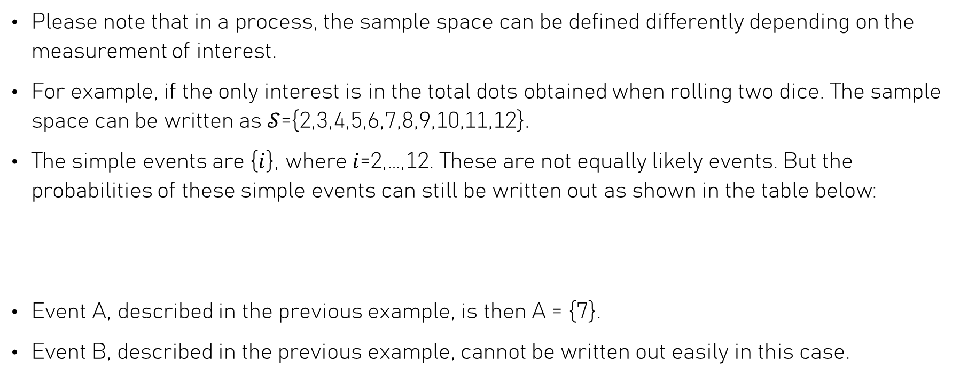
Remarks
Please note that in a process, the sample space can be defined differently depending on the measurement of interest.
For example, if the only interest is in the total dots obtained when rolling two dice. The sample space can be written as $𝒮$={2,3,4,5,6,7,8,9,10,11,12}.
The simple events are {$i$}, where $i$=2,…,12. These are not equally likely events. But the probabilities of these simple events can still be written out as shown in the table below:
Event A, described in the previous example, is then A = {7}.
Event B, described in the previous example, cannot be written out easily in this case.
 | 2 | 3 | 4 | 5 | 6 | 7 | 8 | 9 | 10 | 11 | 12
prob | 1/36 | 2/36 | 3/36 | 4/36 | 5/36 | 6/36 | 5/36 | 4/36 | 3/36 | 2/36 | 1/36

Slide 21
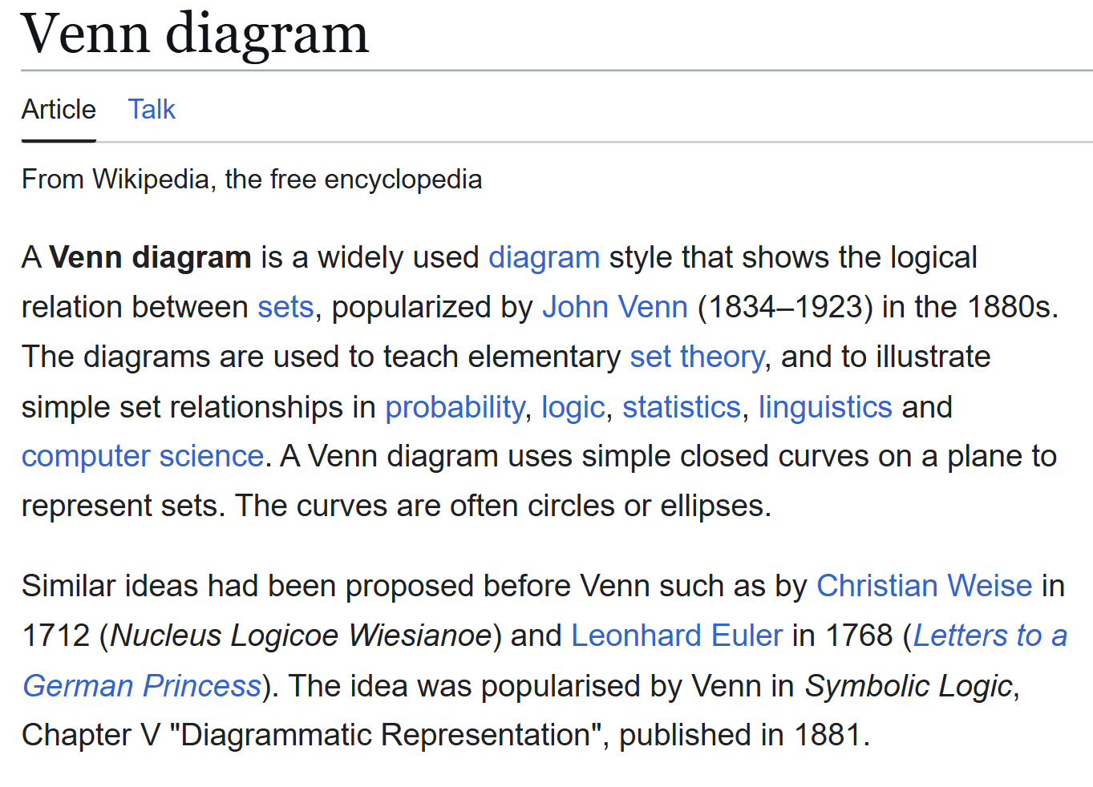
Venn Diagram

Slide 22

Example
Let’s consider a set of integers $𝒮$={1:10}, and events A={1,2,3,4}, B={2,4,6,8}.
Then, a Venn Diagram can be drawn as follows:
5, 7, 9, 10
2,
4,
1, 3,
6, 8,

Slide 23
An Example from Sec. Math 2 Extended
Amara thinks that chocolate ice cream is the greatest! She cannot even imagine that someone saying that bland vanilla is better. She claims that chocolate is the favorite ice cream around the world. Her friend, Isla, thinks that vanilla is much better and more popular. To settle the argument, they create a survey asking people to choose their favorite ice cream flavor between chocolate and vanilla. After completing the survey, the following results came back.
 | Chocolate | Vanilla | Total
Teens | 4732 | 4024 | 8756
Adults | 2420 | 3590 | 6010
Total | 7152 | 7614 | 14766

Slide 24


Example: Chocolate or Vanilla
 | Chocolate | Vanilla | Total
Teens | 4732 | 4024 | 8756
Adults | 2420 | 3590 | 6010
Total | 7152 | 7614 | 14766
Events $C=\left\{Favor Chocolate\right\} and C^{C}=\{Favor Vanilla\}$
Events $A=\left\{Being an Adult\right\} and A^{C}=\{Being a Teen\}$
4024
$$C$$
$$A$$
2420
3590
4732

Slide 25






Tree Diagram
 | Chocolate | Vanilla | Total
Teens | 4732 | 4024 | 8756
Adults | 2420 | 3590 | 6010
Total | 7152 | 7614 | 14766
$$C|A$$
As adults, 2420 favor Chocolate.
$$A$$
6010 Adults
$$C^{c}|A$$
All 14766 people who took the survey
As adults, 3590 favor Vanilla.
$$C|A^{c}$$
Aa teens, 4732 favor Chocolate.
$$A^{C}$$
8756 Teens
$$C^{c}|A^{c}$$
As teens, 4024 favor Vanilla.

Slide 26
Remarks
A survey is often a special kind of observational study.
The chocolate-vanilla example data came from a survey.
The study units are people who took the survey.
The counts and proportions are sample statistics.
We cannot draw a cause-and-effect relationship, but we can discuss the association.
Because we have no information on how the 14766 people were recruited, this may not be a representative sample of the targeted population. Be cautious when generalize the results to a bigger population.

Slide 27
Back to the Discussion of Probabilities
Suppose that we do not have a bigger population of interest.
Suppose that the whole group of 14766 people is the population we are interested in.
Then, the counts and proportions are the summary of the population.
Then, the population proportions can be interpreted as probabilities.
The sample space is the collection of outcomes(responses) of all people
Note:
A sample statistic is a numerical summary of a sample.
A population parameter is a numerical summary of a population.

Slide 28
Revisit Example: Chocolate or Vanilla
 | Chocolate | Vanilla | Total
Teens | 4732 | 4024 | 8756
Adults | 2420 | 3590 | 6010
Total | 7152 | 7614 | 14766
Events $C=\left\{Favor Chocolate\right\} and C^{C}=\{Favor Vanilla\}$
Events $A=\left\{Being an Adult\right\} and A^{C}=\{Being a Teen\}$
4024/14766
$$C$$
$$A$$
2420
14766
4732/14766
3590/14766

Slide 29
Revisit Tree Diagram
 | Chocolate | Vanilla | Total
Teens | 4732 | 4024 | 8756
Adults | 2420 | 3590 | 6010
Total | 7152 | 7614 | 14766
$$C|A$$
As adults, 2420/6010 favor Chocolate.
$$A$$
6010/14766 Adults
$$C^{c}|A$$
All (100%) people who took the survey
As adults, 3590/6010 favor Vanilla.
$$C|A^{c}$$
Aa teens, 4732/8756 favor Chocolate.
$$A^{C}$$
8756/14766 Teens
$$C^{c}|A^{c}$$
As teens, 4024/8756 favor Vanilla.

Slide 30
More Remarks
We use proportions as probabilities because we suppose that each person in the population has the same chance to be selected, and each of their responses (outcomes) has the same likelihood to appear in the sample space.

Slide 31
Interesting Probabilities
What is the probability that a randomly selected adult favors the chocolate flavor?
What is the probability that a randomly selected person is an adult and favors the chocolate flavor?
What is the probability that a randomly selected person is an adult?

Slide 32
Conditional Probabilities
 | Chocolate | Vanilla | Total
Teens | 4732 | 4024 | 8756
Adults | 2420 | 3590 | 6010
Total | 7152 | 7614 | 14766
What is the probability that a randomly selected adult favors the chocolate flavor?
$$\operatorname{Pr}\left(C | A\right)=\frac{Pr⁡(A ∩C)}{P(A)}$$
Note: Pr(C|A) is read as “probability of C given A”.

Slide 33
Joint Probability
 | Chocolate | Vanilla | Total
Teens | 4732 | 4024 | 8756
Adults | 2420 | 3590 | 6010
Total | 7152 | 7614 | 14766
What is the probability that a randomly selected person is an adult and favors the chocolate flavor?
$$Pr⁡(A ∩C)$$

Slide 34
Marginal Probability
 | Chocolate | Vanilla | Total
Teens | 4732 | 4024 | 8756
Adults | 2420 | 3590 | 6010
Total | 7152 | 7614 | 14766
What is the probability that a randomly selected person is an adult?
$$Pr⁡(A)$$

Slide 35
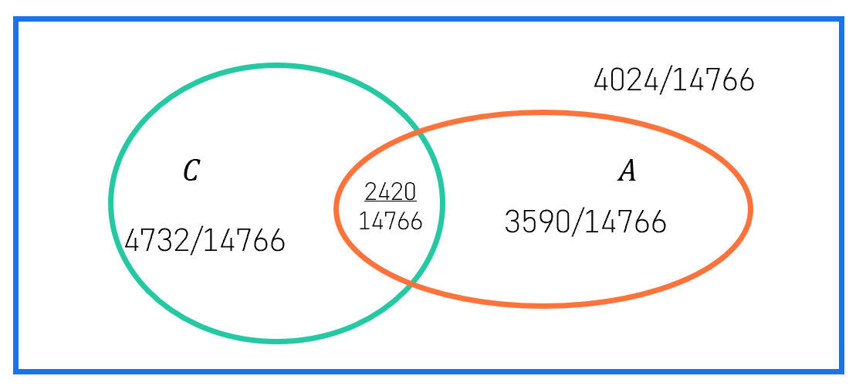
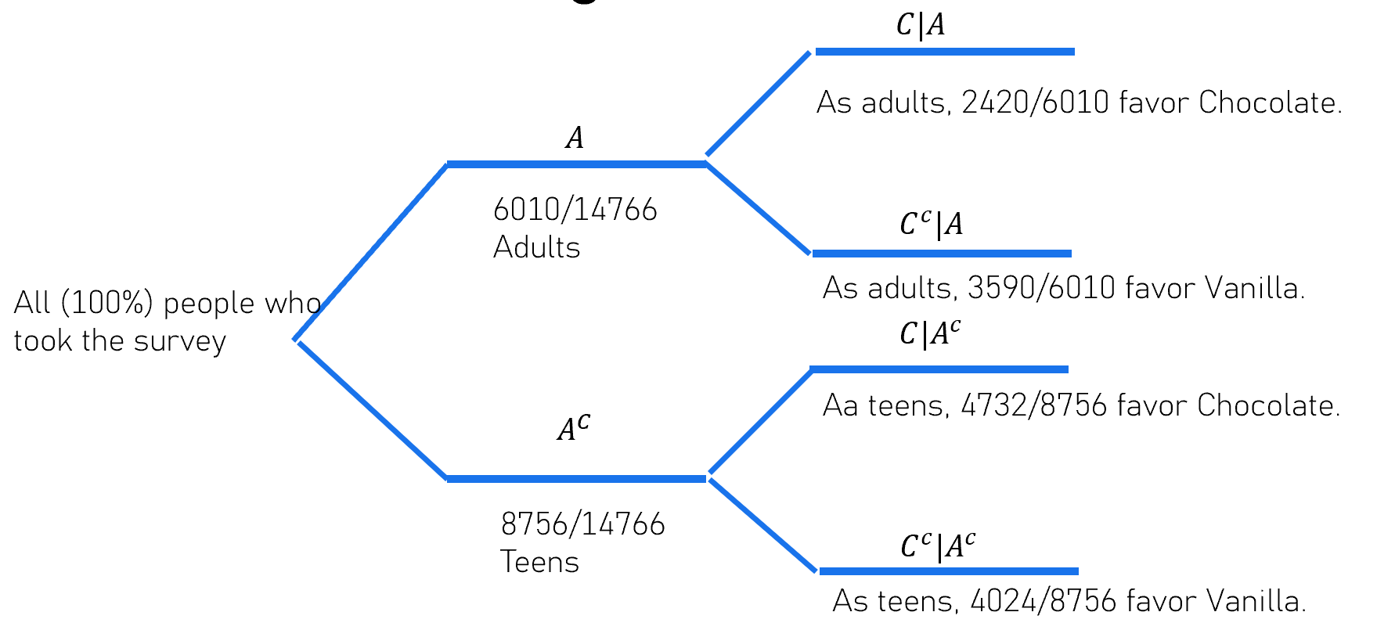


Let’s try more
 | Chocolate | Vanilla | Total
Teens | 4732 | 4024 | 8756
Adults | 2420 | 3590 | 6010
Total | 7152 | 7614 | 14766
$\operatorname{Pr}\left(C\right)$
$\operatorname{Pr}\left(A^{c}\right)$
$\operatorname{Pr}\left(C^{c}\right)$
$Pr⁡(A^{c} ∩C)$
$Pr⁡(A ∩ C^{c})$
$Pr⁡(A^{c} ∩C^{c})$
$\operatorname{Pr}\left(C^{c}|A\right)$
$\operatorname{Pr}\left(C|A^{c}\right)$
$\operatorname{Pr}\left(C^{c}|A^{c}\right)$
$\operatorname{Pr}\left(A|C\right)$
$\operatorname{Pr}\left(A^{c}|C\right)$
$\operatorname{Pr}\left(A|C^{c}\right)$
$\operatorname{Pr}\left(A^{c}|C^{c}\right)$

Slide 36
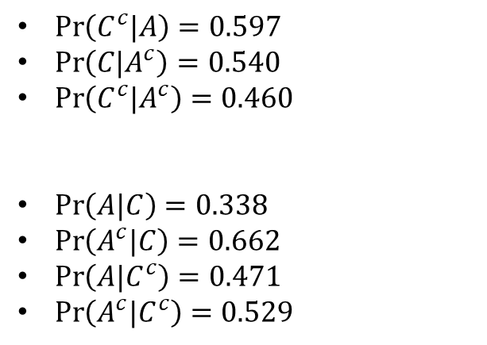
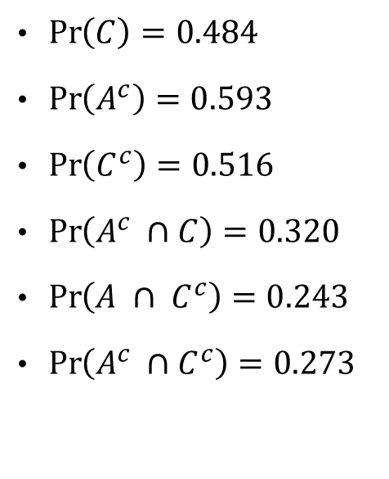
Let’s try more
 | Chocolate | Vanilla | Total
Teens | 4732 | 4024 | 8756
Adults | 2420 | 3590 | 6010
Total | 7152 | 7614 | 14766
$\operatorname{Pr}\left(C\right)=0.484$
$\operatorname{Pr}\left(A^{c}\right)=0.593$
$\operatorname{Pr}\left(C^{c}\right)=0.516$
$\operatorname{Pr}\left(A^{c} ∩C\right)=0.320$
$\operatorname{Pr}\left(A ∩ C^{c}\right)=0.243$
$\operatorname{Pr}\left(A^{c} ∩C^{c}\right)=0.273$
$\operatorname{Pr}\left(C^{c}|A\right)=0.597$
$\operatorname{Pr}\left(C|A^{c}\right)=0.540$
$\operatorname{Pr}\left(C^{c}|A^{c}\right)=0.460$
$\operatorname{Pr}\left(A|C\right)=0.338$
$\operatorname{Pr}\left(A^{c}|C\right)=0.662$
$\operatorname{Pr}\left(A|C^{c}\right)=0.471$
$\operatorname{Pr}\left(A^{c}|C^{c}\right)=0.529$

Slide 37

Let’s try another example
Pr(Soccer)=0.4
Pr(Pizza)=0.25
Pr(Soccer and Pizza)=0.1
Soccer
Pizza
$$\operatorname{Pr}\left(Soccer ∪Pizza\right)=?$$

Slide 38

Another way to solve
Pr(Soccer)=0.4
Pr(Pizza)=0.25
Pr(Soccer and Pizza)=0.1
 | Soccer | Not Soccer | Total
Pizza | 0.1 |  | 0.25
Not Pizza
Total | 0.4 |  | 1.00
$$\operatorname{Pr}\left(Soccer ∪Pizza\right)=?$$
Pr( Soccer or Pizza) = (0.4-0.1) + (0.25 – 0.1)+0.1 = 0.4 + 0.25 – 0.1

Slide 39
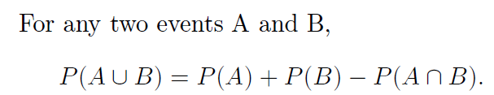
Addition Rule

Slide 40







One More Example
$$\operatorname{Pr}{(A|B)}=?$$
$$\operatorname{Pr}\left(B | A\right)=0.35$$
Fish
$$Pr\left(A\right)=0.6$$
Fried
$${Pr⁡(B}^{c}\left|A\right)=0.65$$
Chicken
All
$$Pr\left(B | A^{c}\right)=0.2$$
Fish
$${Pr⁡(A}^{c})=0.4$$
Grilled
$${Pr(B}^{c}\left|A^{c}\right)=0.8$$
Chicken

Slide 41
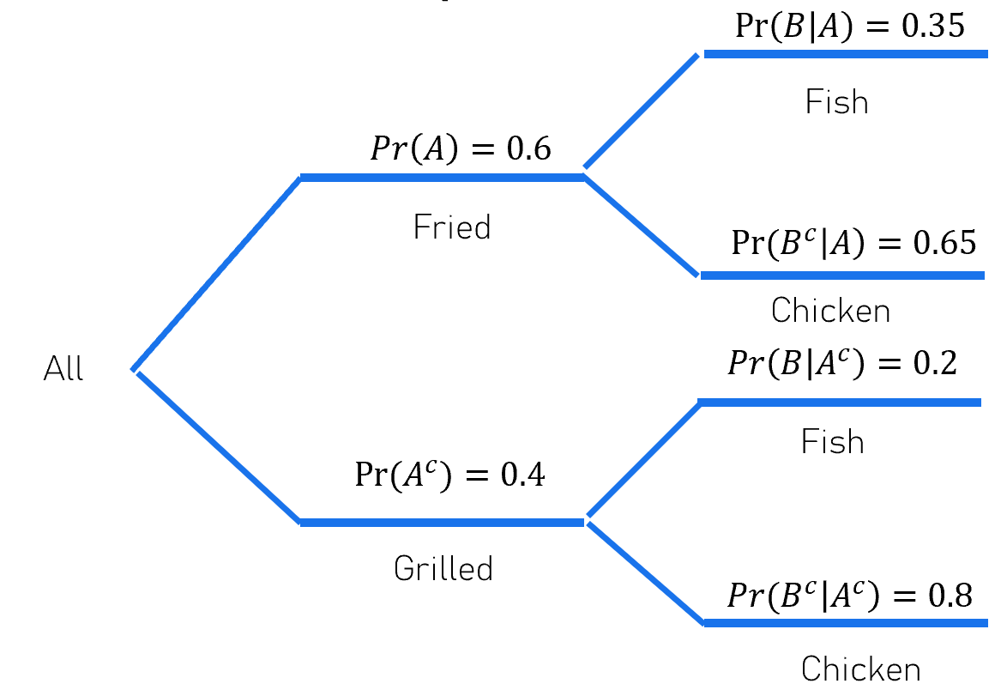
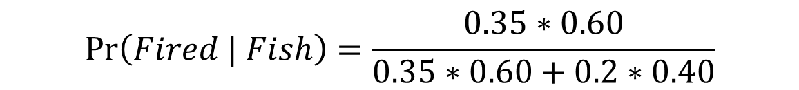

My Intuition
 | Fish | Chicken | Total
Fried | 0.35*0.60 | 0.65*0.60 | 0.60
Grilled | 0.2*0.40 | 0.8*0.40 | 0.40
Total |  |  | 1.00
$$\operatorname{Pr}\left(Fired | Fish\right)=\frac{0.35∗0.60}{0.35∗0.60+0.2∗0.40}$$
$$\operatorname{Pr}{(A|B)}=?$$

Slide 42
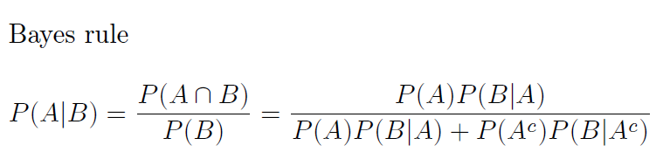
Bayes’ Rule

Slide 43
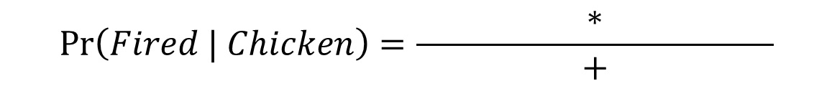
Pr(Fried|Chicken)
 | Fish | Chicken | Total
Fried | 0.35*0.60 | 0.65*0.60 | 0.60
Grilled | 0.2*0.40 | 0.8*0.40 | 0.40
Total |  |  | 1.00
$$\operatorname{Pr}\left(Fired | Chicken\right)=\frac{∗}{ + }$$

Slide 44
Pr(Grillled|Chicken)
 | Fish | Chicken | Total
Fried | 0.35*0.60 | 0.65*0.60 | 0.60
Grilled | 0.2*0.40 | 0.8*0.40 | 0.40
Total |  |  | 1.00
$$\operatorname{Pr}\left(Fired | Chicken\right)=\frac{∗}{ + }$$

Slide 45
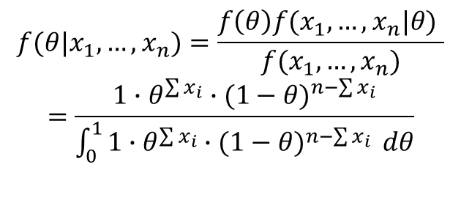
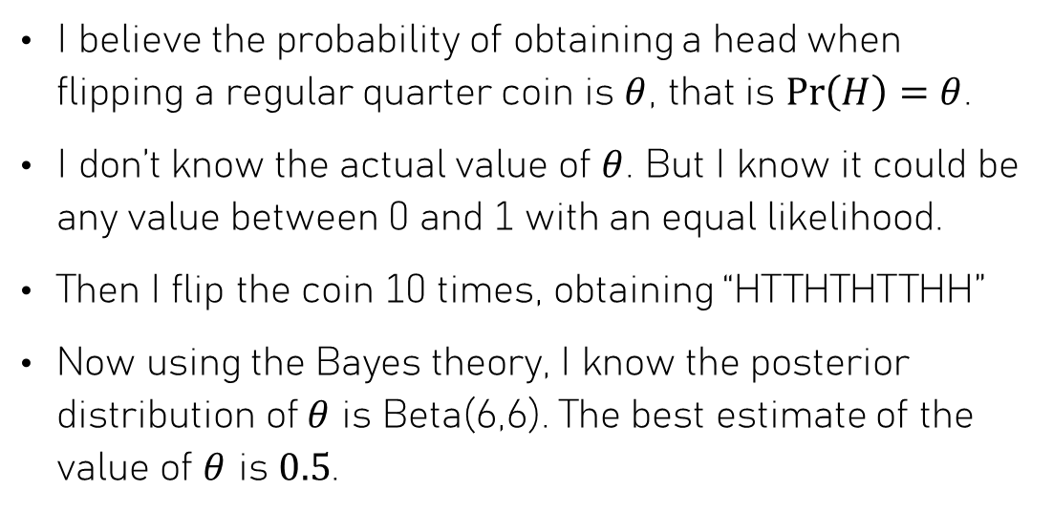
Application of the Bayes Rule - This is too much for us, neglect if not interested in
I believe the probability of obtaining a head when flipping a regular quarter coin is $θ$, that is $\operatorname{Pr}\left(H\right)=θ$.
I don’t know the actual value of $θ$. But I know it could be any value between 0 and 1 with an equal likelihood.
Then I flip the coin 10 times, obtaining “HTTHTHTTHH”
Now using the Bayes theory, I know the posterior distribution of $θ$ is Beta(6,6). The best estimate of the value of $θ$ is $0.5$.
$$f(θ|x_{1},…,x_{n})=\frac{f\left(θ\right)f(x_{1},…,x_{n}|θ) }{f(x_{1},…,x_{n})}$$
$$=\frac{1∙θ^{\sum{x_{i}}}∙{(1−θ)}^{n−\sum{x_{i}}}}{\int_{0}^{1}{1∙θ^{\sum{x_{i}}}∙{(1−θ)}^{n−\sum{x_{i}}}} dθ}$$

Slide 46
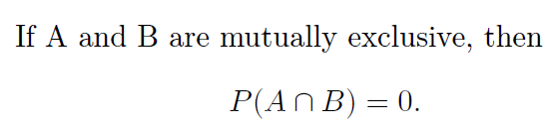
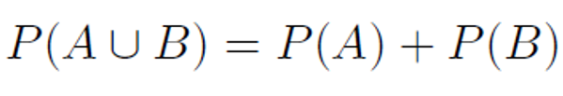
Relationship: Mutually Exclusive
A
B
The converse is true too.
This relationship is also called disjoint.
As a result,

Slide 47
Example: Rolling One Die
A=getting a 6 = {6}
B=getting a 1 = {1}
A and B are mutually exclusive.
A
B

Slide 48
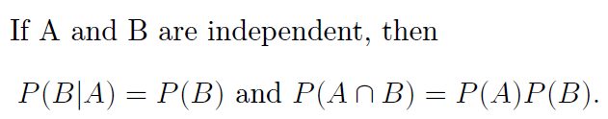
Relationship: Independent
A
B
The converse is true too.

Slide 49
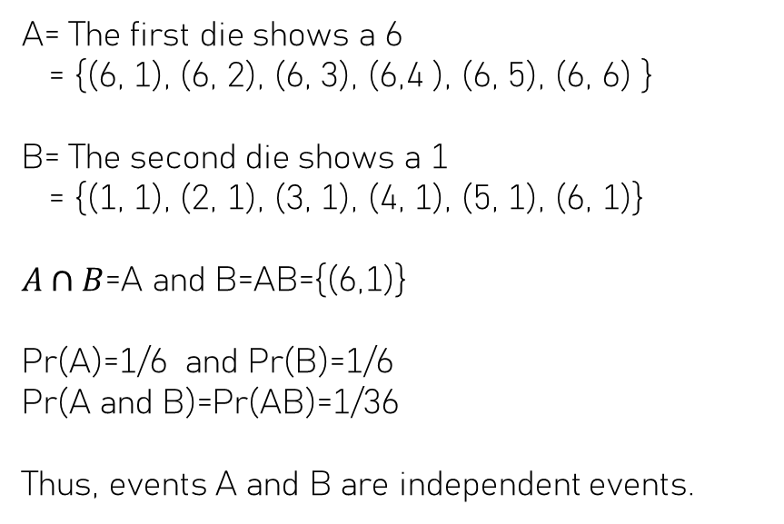
Example: Rolling Two Dice
A= The first die shows a 6
= {(6, 1), (6, 2), (6, 3), (6,4 ), (6, 5), (6, 6) }
B= The second die shows a 1
= {(1, 1), (2, 1), (3, 1), (4, 1), (5, 1), (6, 1)}
$A∩B$=A and B=AB={(6,1)}
Pr(A)=1/6 and Pr(B)=1/6
Pr(A and B)=Pr(AB)=1/36
Thus, events A and B are independent events.
A
B

Slide 50
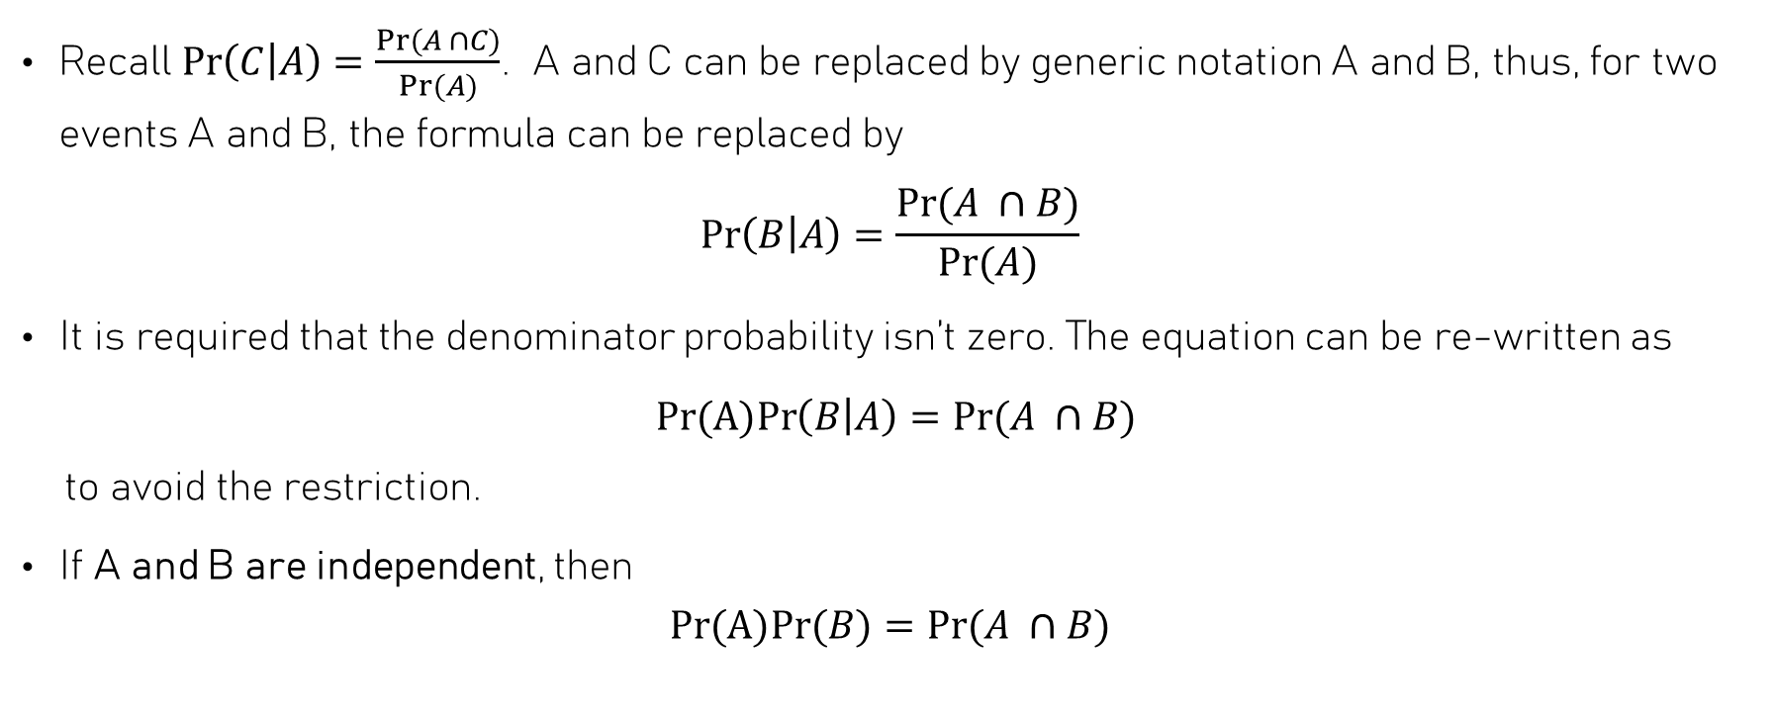
Remarks
Recall $\operatorname{Pr}\left(C | A\right)=\frac{Pr⁡(A ∩C)}{Pr⁡(A)}$. A and C can be replaced by generic notation A and B, thus, for two events A and B, the formula can be replaced by
$$\operatorname{Pr}\left(B | A\right)=\frac{Pr⁡(A ∩B)}{Pr⁡(A)}$$
It is required that the denominator probability isn’t zero. The equation can be re-written as
$Pr(A)Pr\left(B | A\right)=Pr⁡(A ∩B)$
to avoid the restriction.
If A and B are independent, then
$$Pr(A)Pr{(B)}=Pr⁡(A ∩B)$$

Slide 51
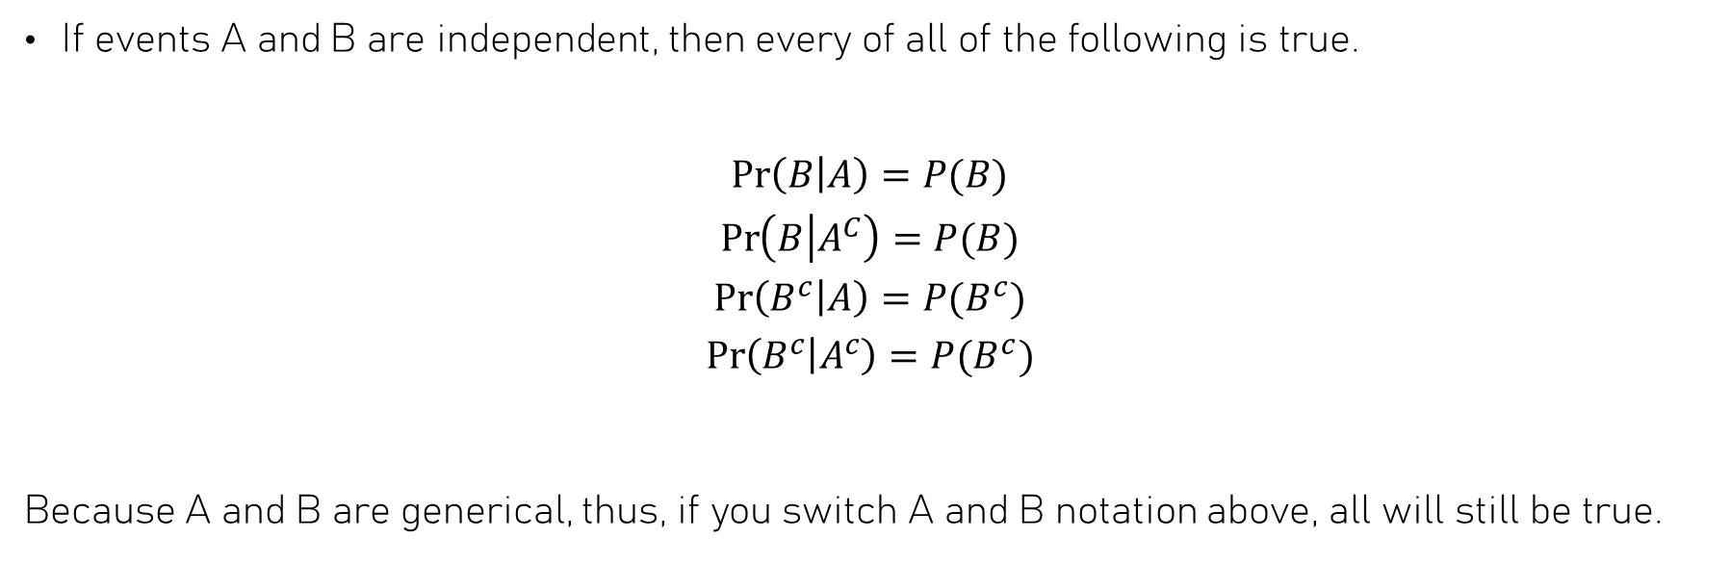
Remarks
If events A and B are independent, then every of all of the following is true.
$$\operatorname{Pr}\left(B | A\right)=P(B)$$
$$\operatorname{Pr}\left(B | A^{C}\right)=P(B)$$
$$\operatorname{Pr}\left(B^{c} | A\right)=P(B^{c})$$
$$\operatorname{Pr}\left(B^{c} | A^{c}\right)=P(B^{c})$$
Because A and B are generical, thus, if you switch A and B notation above, all will still be true.

Slide 52
Remarks
Given two non-empty events A and B.
Then,
If A and B are independent, they cannot be mutually exclusive.
If A and B are mutually exclusive, they cannot be independent.

Slide 53
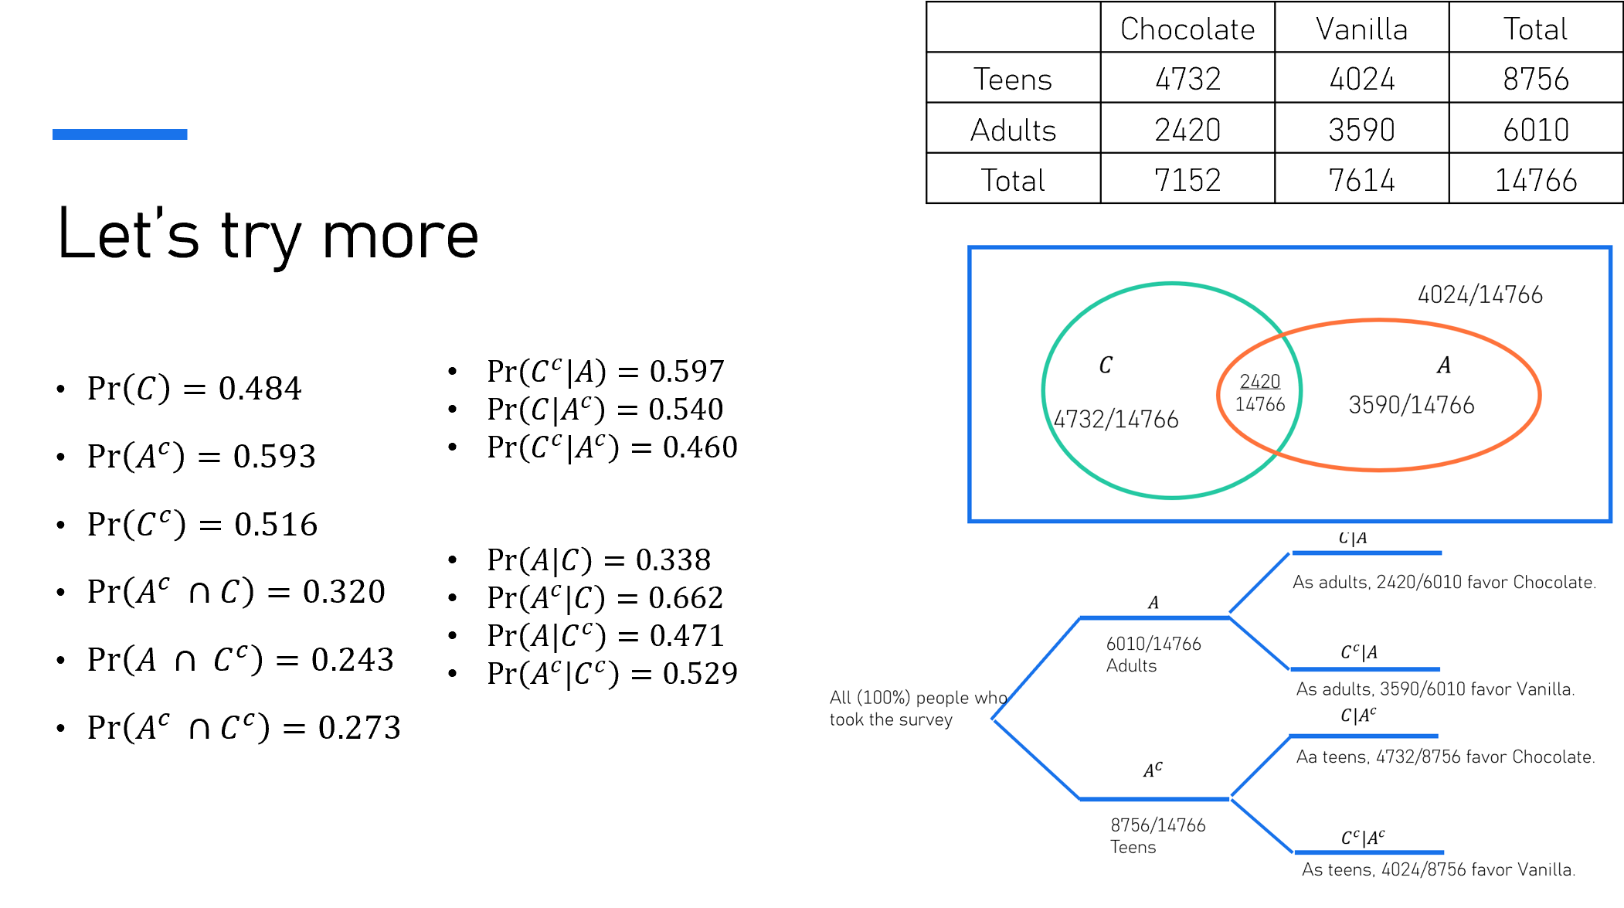
Note: Obviously, A and C are not mutually exclusive. There are people who are adults and who love the Chocolate flavor.
A and C are not independent. Pr(C)=0.484 but Pr(C|A)=0.403
Overall, 48.4% of people chose the Chocolate flavor.
But if we only look at the adults, only 40.3% chose the Chocolate flavor.
The probability of liking the Chocolate flavor changes/depends on a person’s age.
Please remember that the interpretation of the above results is based on the assumption that we treat all 14766 people as a population.

Slide 54
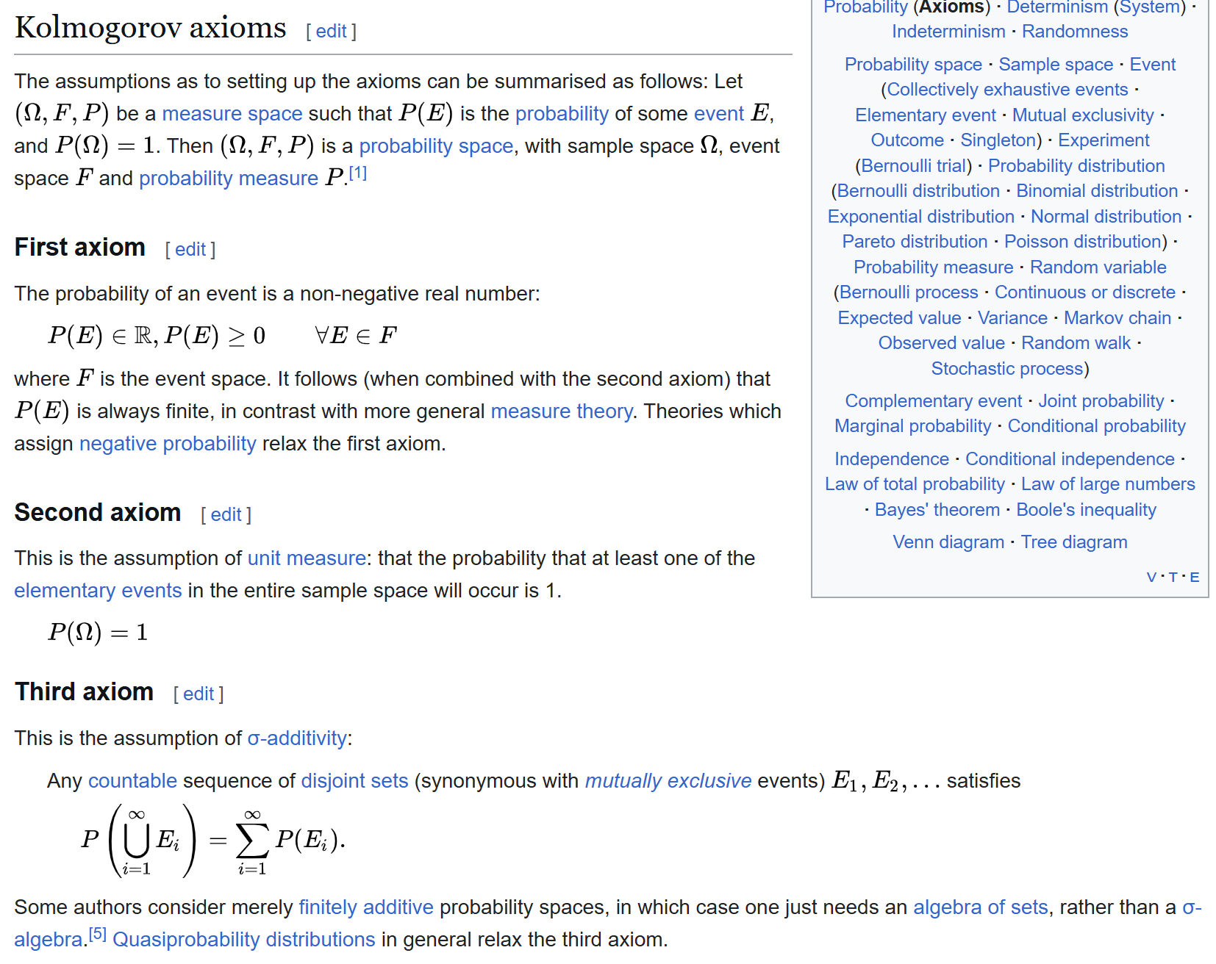
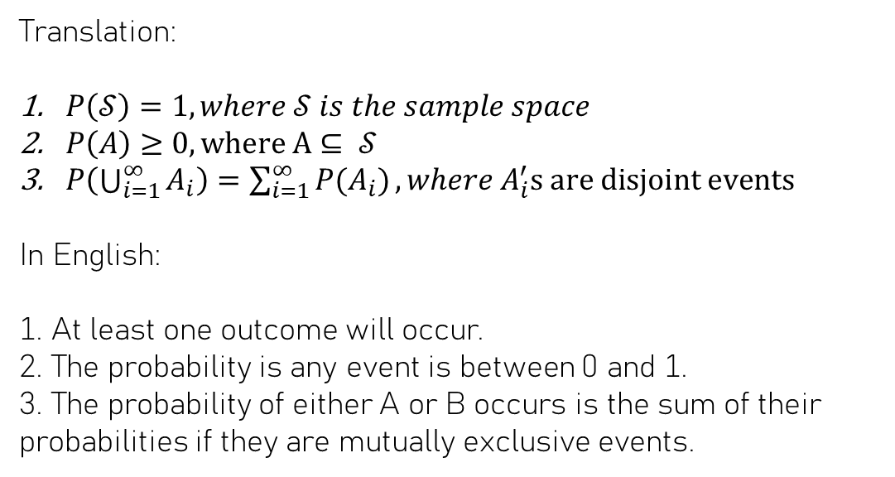
Probability Axioms
Translation:
$P\left(𝒮\right)=1, where 𝒮 is the sample space$
$P\left(A\right)≥0, where A⊆ 𝒮$
$P\left(\bigcup_{i=1}^{∞}{A_{i}}\right)=\sum_{i=1}^{∞}{P(A_{i})}, where A_{i}^{′}s are disjoint events$
In English:
1. At least one outcome will occur.
2. The probability is any event is between 0 and 1.
3. The probability of either A or B occurs is the sum of their probabilities if they are mutually exclusive events.

Slide 55
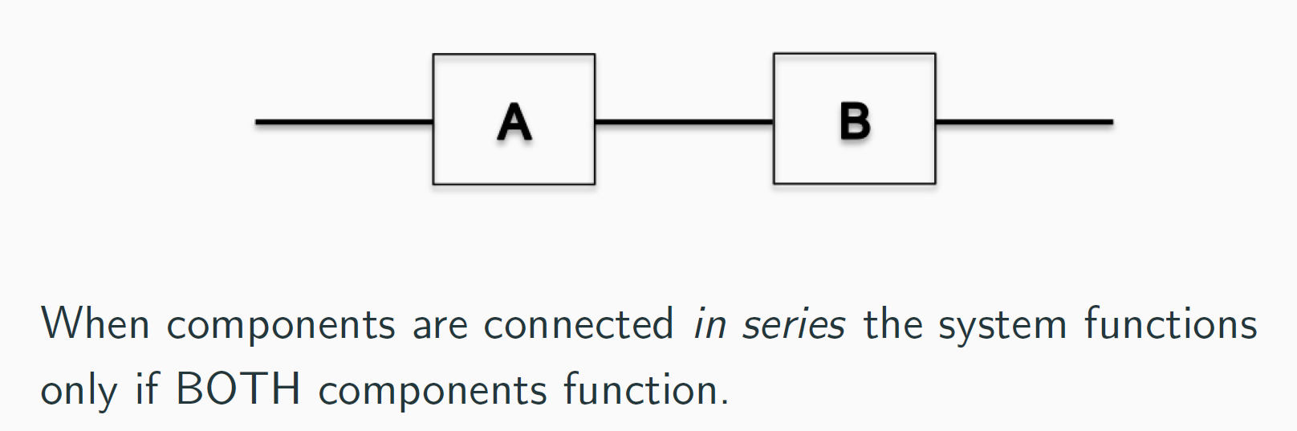
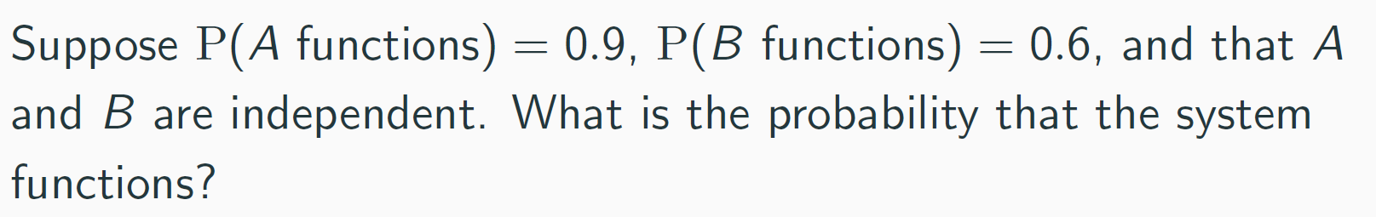
Some Additional Examples for HW: Part I

Slide 56
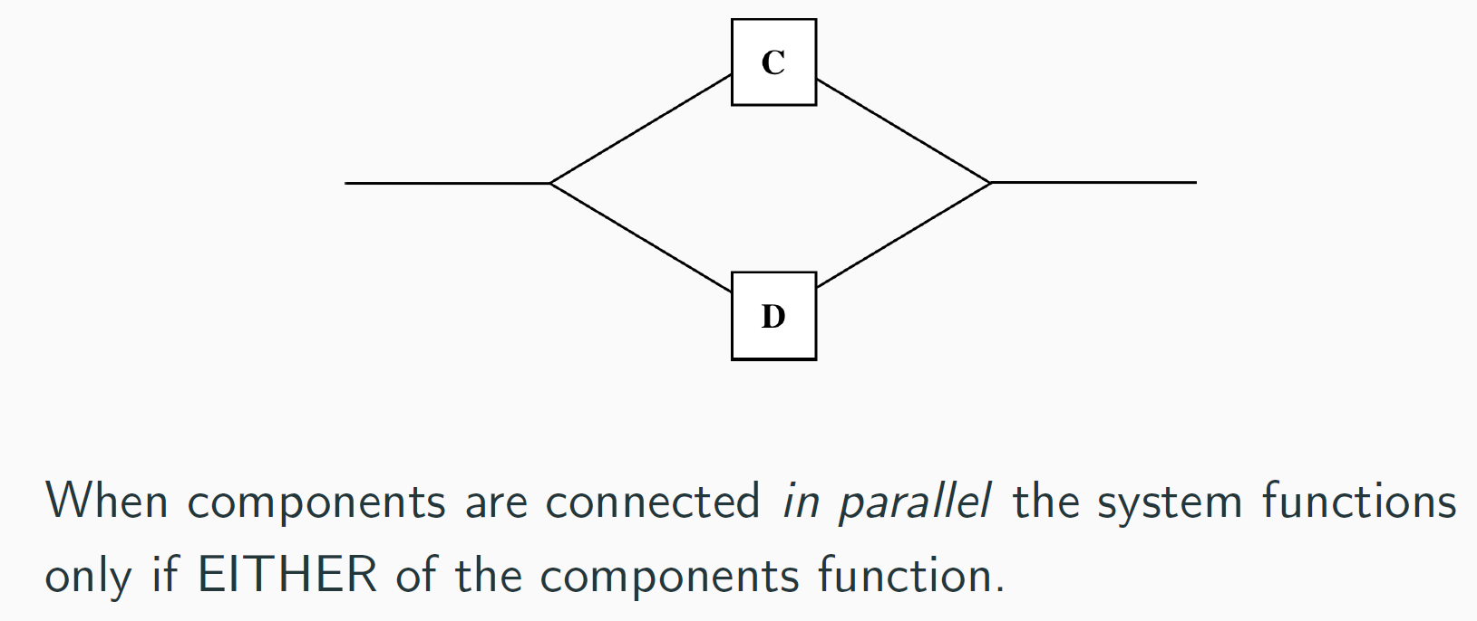
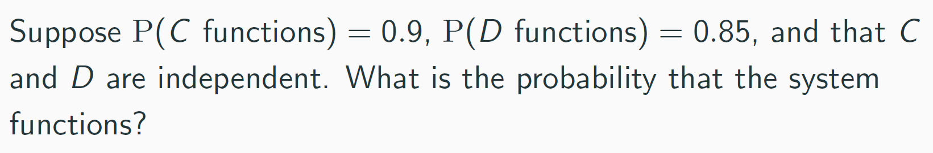
Some Additional Examples for HW: Part II

Slide 57
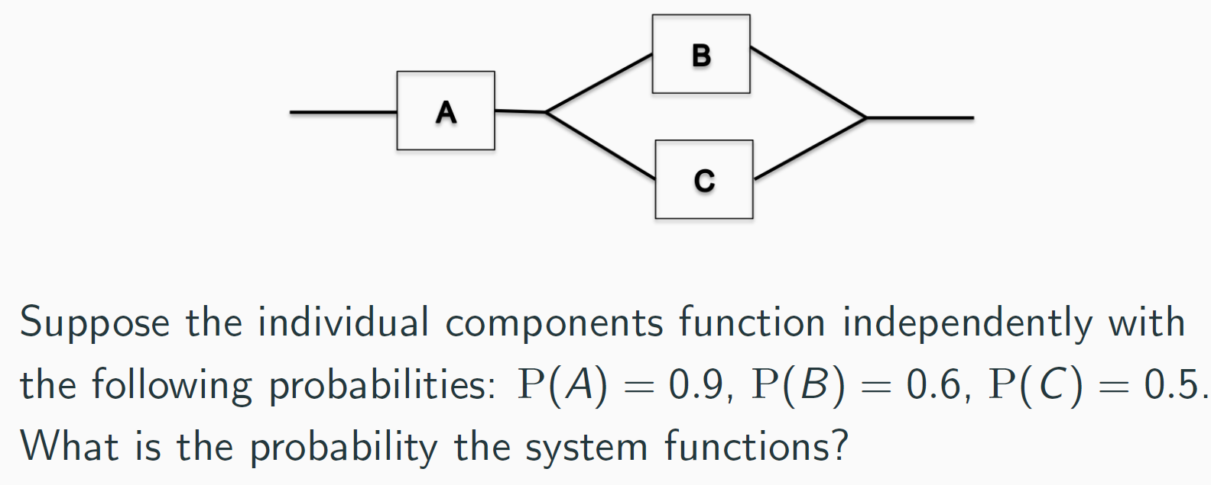
Some Additional Examples for HW: Part III

Slide 58
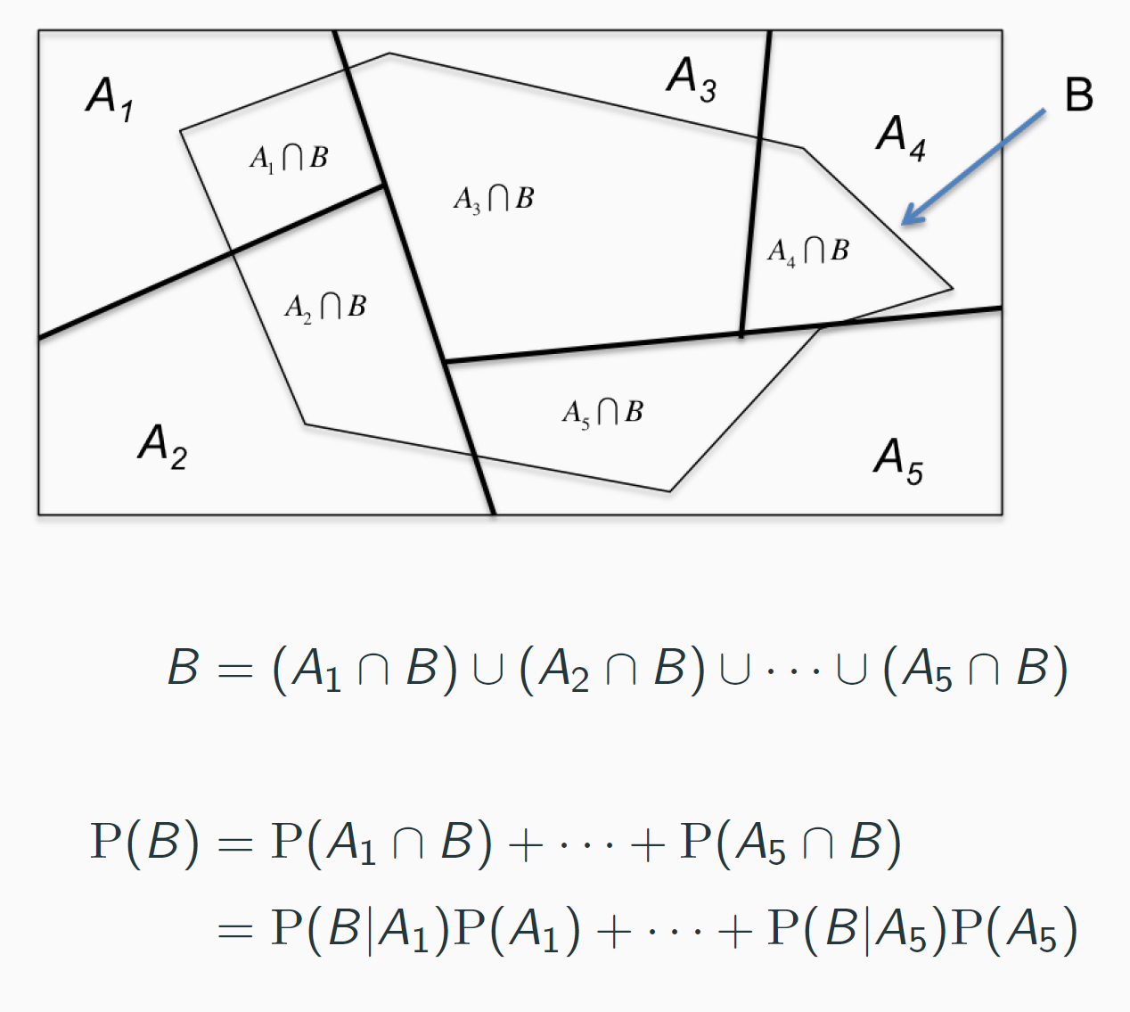
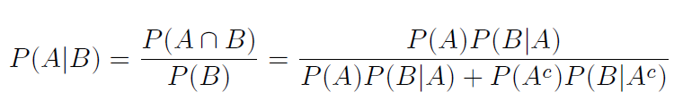
Honorable Mention: The Law of Total Probability
This is a result derived by Axiom 3 and the conditional probability equation.

Slide 59
Summary
Sample Space and Events
Probabilities of Events
Probabilities of Complement, Union, and Intersection of Events
Venn Diagram and Tree Diagram
Conditional, Joint, and Marginal Probabilities
Addition Rule
Bayes Rule
Two Types of Relationship – Mutually Exclusive and Independent
Probability Axioms
Honorable Mention: The Law of Total Probability

Slide 60
Quote of the Day
Doctrine and Covenants 46:26
And all these gifts come from God, for the benefit of the children of God.
The scripture verses I shared may not show the signs of connections to our lessons about statistics. These are just the scriptures I read by following “Come, Follow Me” Weekly readings. You are also welcome to recommend any verse you want to share. Just let me know.

Slide 61
Typos?
Please email me any typos and errors you found in this lesson.
Thank you!

